Slide 1




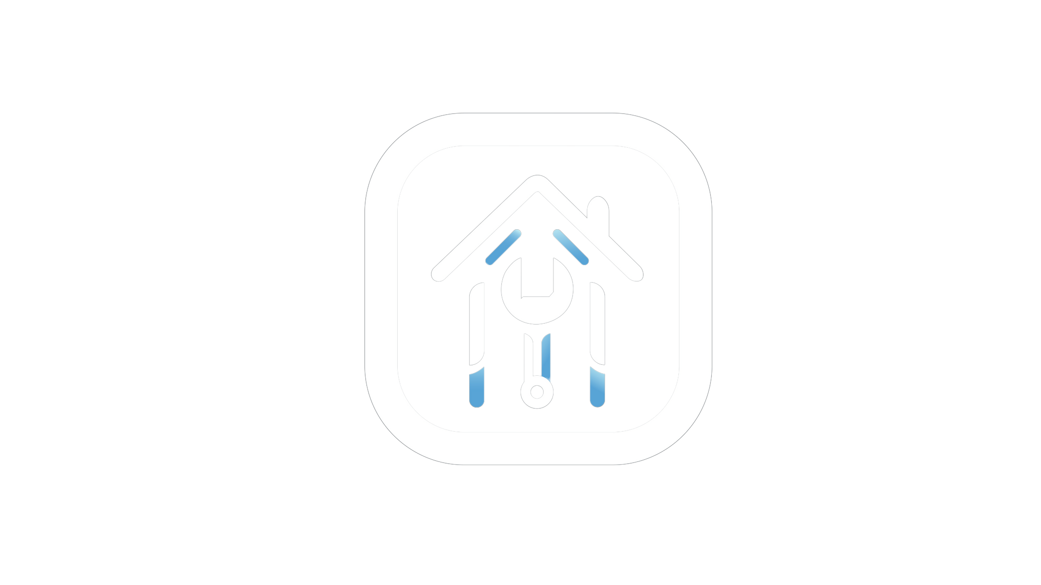



Fix Flex
Supervised by :
Dr. Helal Ahmed Soliman

Slide 2

HELLO! WE ARE
FIX FLEX
MEET OUR TEAM?

Slide 3







FIXFLEX TEAM
AHMED
MENNA
MOUSTAFA
ISRAA
AISHA
BASMALA

Slide 4




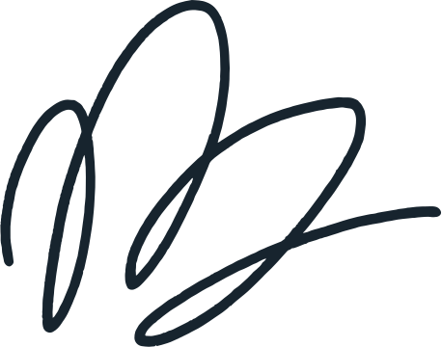

PROJECT’S IDEA

Slide 5

What Fix Flex Helps With
Finding Experienced Taskers Easily
Setting Your Preferred Budget
Finding Jobs quickly For Taskers
Building A Tasker’s Reputation

Slide 6

Problem Statement

Slide 7




01.
Finding a trustworthy handyman is challenging
Disputes often arise over previously agreed budgets
02.
The Problems
Renovations may necessitate hiring several handymen simultaneously
03.
Finding immediate tasks for handymen can be tough
04.

Slide 8





The Solutions
01
02
03
04
Fix Flex Allows for users to rate taskers after each task is completed, making it easier to find dependable handymen.
Our platform facilitates clear and upfront budget agreements, minimizing disputes between users and taskers
Fix Flex makes it easy to find handymen for simple tasks like cleaning, ensuring quick and efficient service for everyday needs
Users can manage multiple tasks and communicate with multiple handymen simultaneously, streamlining the process for complex projects like renovations

Slide 9



Similar Apps

Slide 10

Fixawy
Fixawy Offers technical support to ensure you have everything you need to perform your job better.
Advantage
In Fixawy Everything has a prefixed price that you cannot negotiate.
Disadvantage

Slide 11
Task Rabbit
TaskRabbit conducts background checks on its taskers, ensuring users have access to trusted and reliable professionals.
Advantage
The platform can be somewhat complex for new users to navigate, especially with additional service fees and options.
Disadvantage

Slide 12
Home Run
Home Run offers a wide range of options for the tasks you need done with pre-set categories
Advantage
Disadvantage
Home Run requires a tasker to have a seperate account for tasker and user role which offers low flexibility

Slide 13



Why Fix Flex Is Better
Taskers can set their own budget for user approval, minimizing payment disputes and ensuring clear agreement on costs.
Users can be both taskers and users with one account, offering more flexibility without managing multiple accounts
Our AI Assistant simplifies task posting by automatically filling in the details based on a brief description, saving time and effort

Slide 14

Our Project’s Objective
Ease Of Use
User Verification and Trust
Users can easily find handymen for their day-to-day tasks around the house with a simple sign up and posting process
Fix Flex implements a thorough verification process for taskers, ensuring that only trustworthy and reliable professionals are available for hire
Enhanced Flexibility
Simplify Posting and Hiring
By allowing users to switch between being a tasker and a user with a single account, we offer greater flexibility and convenience
Our platform uses AI to automate task posting, saving users time and effort where they can post the task with a few simple steps

Slide 15
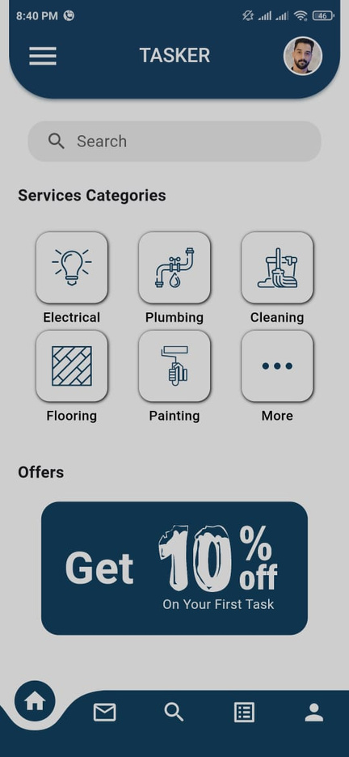

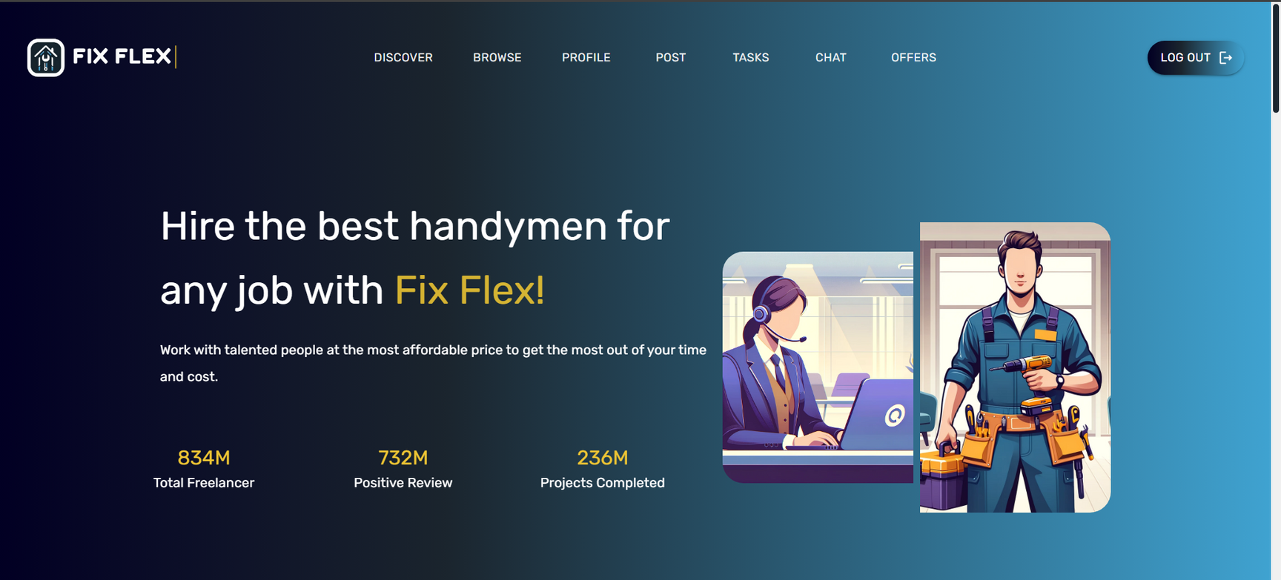
Fix Flex Dashboard

Slide 16
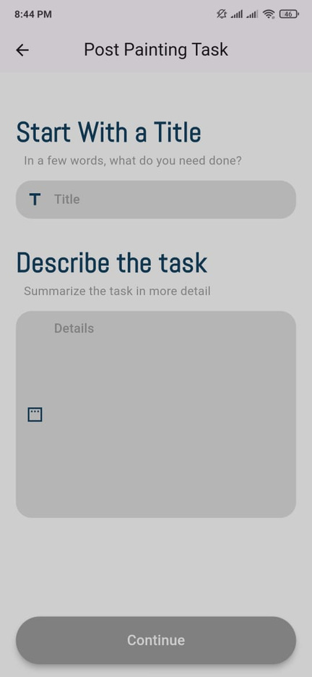
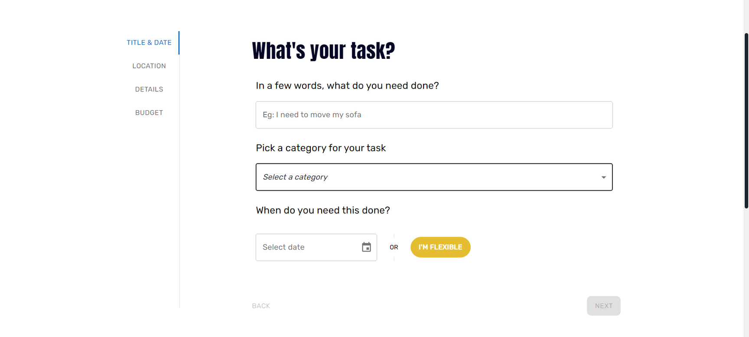
Post A Task

Slide 17
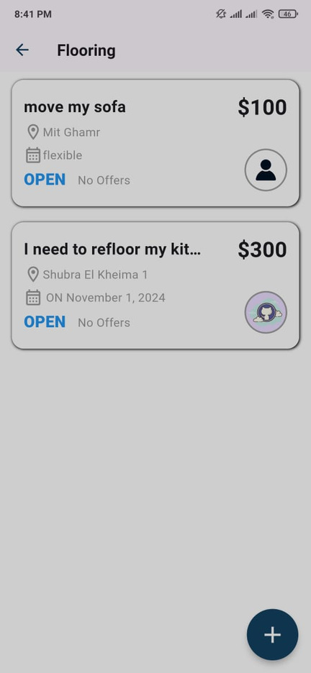
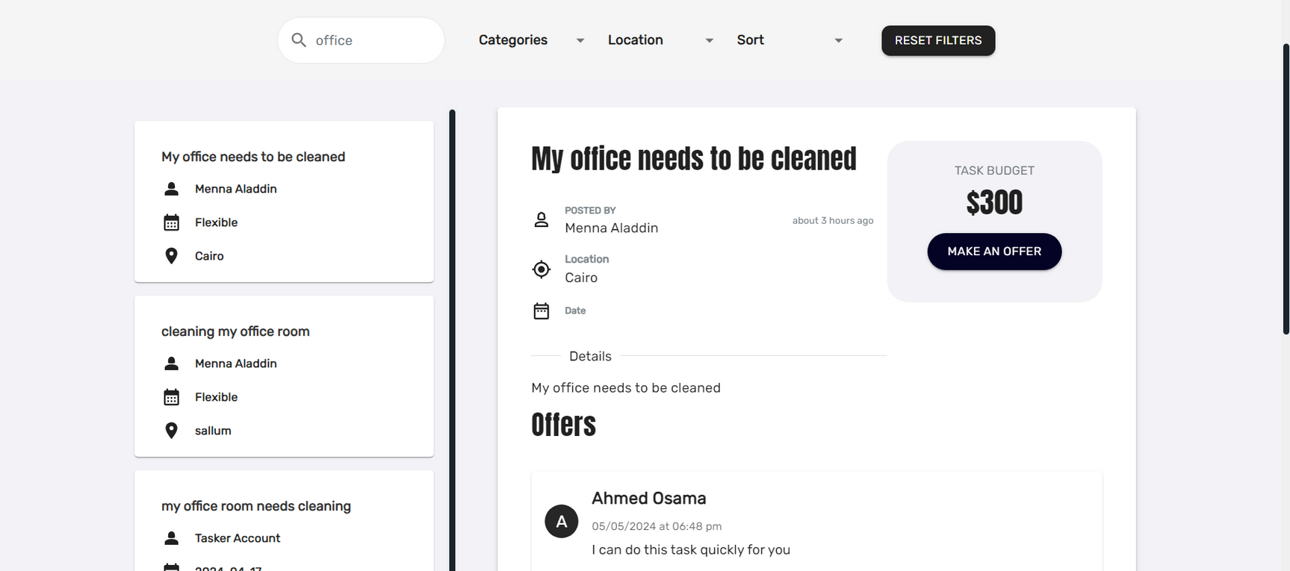
Browse Tasks

Slide 18
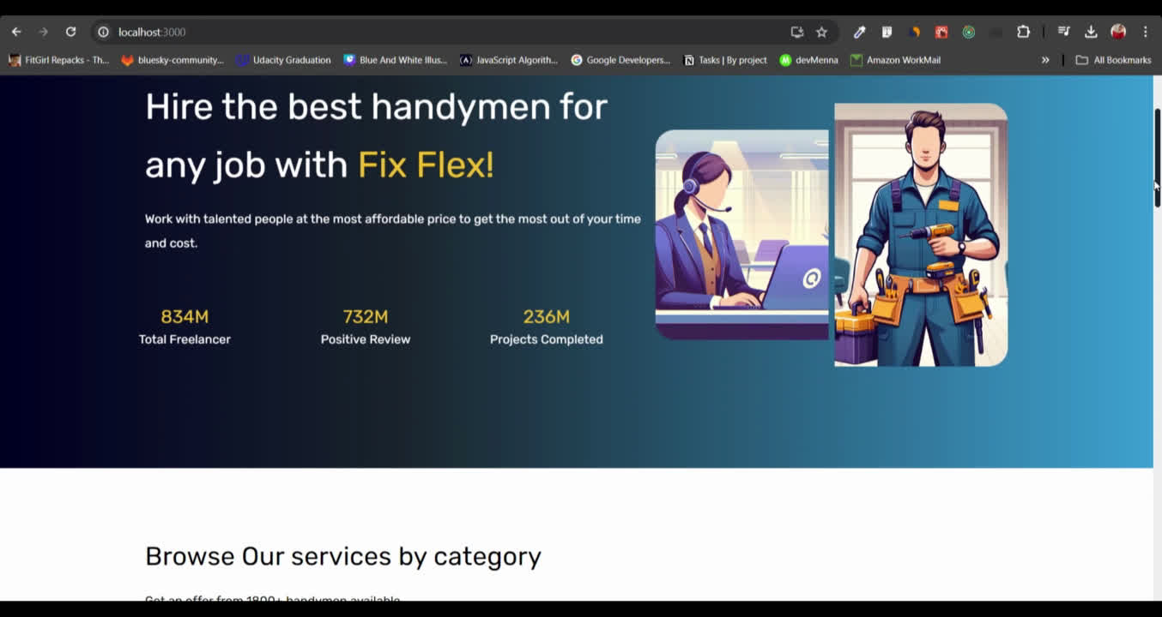
Fix Flex Live Demo

Slide 19

Final reflections and future steps
At Fix Flex, we are committed to continuously improving our platform to meet the evolving needs of our users.
By listening to our community and implementing their feedback, we aim to provide a seamless and reliable experience for both users and taskers.
With a roadmap full of exciting features and enhancements, we are dedicated to making Fix Flex the go-to platform for all household task needs.

Slide 20

HAVE A QUESTION?

Slide 21
THANK YOU

